Slide 1
Citi Bike Data Hypotheses
Assignment 5: Test Hypotheses
Arnav Dashaputra

Slide 2
Hypothesis 1: Increased Average Ride Time in 2021
I made this hypothesis with the reason being that people in 2021 are more cautious and understanding of the implications of the virus (e.g. how it spreads, methods of contraction, etc.) and are willing to take the risk and use citi bikes. Additionally, I believe that more people in 2020 are working from home than in 2021, and so with more people commuting, the usage and average ride time of citi bikes will be greater.

Slide 3
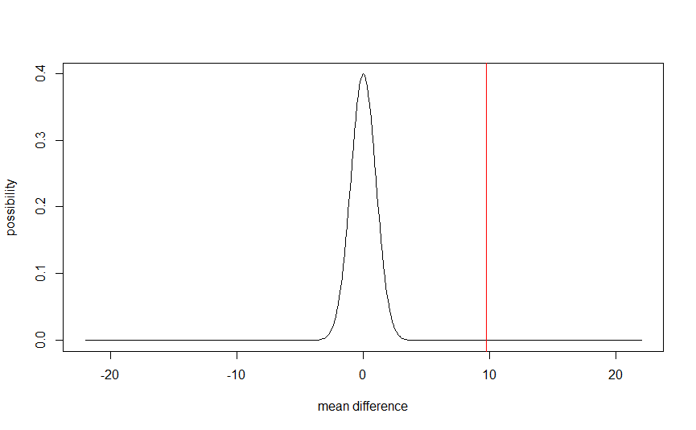
Hypothesis 1 - Calculations and Data
The data that I got actually contradicted my hypothesis. I got a z-score of 9.753, and a p value so small that it evaluated to 0, meaning that it is almost impossible that my findings/result happened by chance.
The null hypothesis here is that there is no significant difference in average ride time between the two years. We can reject the null hypothesis, as there is strong data suggesting that in 2021, there was a smaller average ride time.

Slide 4
Hypothesis 1 - Findings
There are a few reasons that can point towards my result. First, is that last year, people used the citi bikes out of a dire necessity to travel, especially for traveling further places. If people that needed to travel had not needed to go that far, they would have opted to walk instead of using a potentially “contaminated” bike. Another reason to not bike short distances is to save money on bike fares.
This year, people traveling shorter distances might take the bikes just for ease of access with less concern. Additionally, the economy has sprung back to the point where many people found new jobs and are able to use that extra money on transportation.

Slide 5
Hypothesis 2 - Increased Subscriber Rates
I made this hypothesis with the reason being that in 2020, people were just not traveling as much using the citi bikes, and so they did not need subscribers. This data could go hand in hand with average amounts of citi bike users. Otherwise, to add on to this hypothesis, the same reasoning from the first hypothesis of users not needing to travel for specific reasons remains.

Slide 6
Hypothesis 2 - Calculations and Data
Although the data shows that the amount of subscribers stayed the same, I was not able to get a precise value for the standard deviations, as I did not have enough knowledge in R to use the values of “subscriber” and “customer” in the context of standard deviation. I attempted to reassign these values to numerical representations (1 for subscriber and 2 for customer) and find the standard deviation this way (see R script).
The null hypothesis here is that there is no significant difference in the amount of users that are subscribers between the two years. We can support the null hypothesis, as there is evidence showing that the number of subscribers in 2020 and 2021 remained relatively the same.

